Slide 1

Build Your First AI-Powered Web App
Using Replit – No Local Setup, No Coding Deep Dive
Presenter: Siddharth Singh

Slide 2
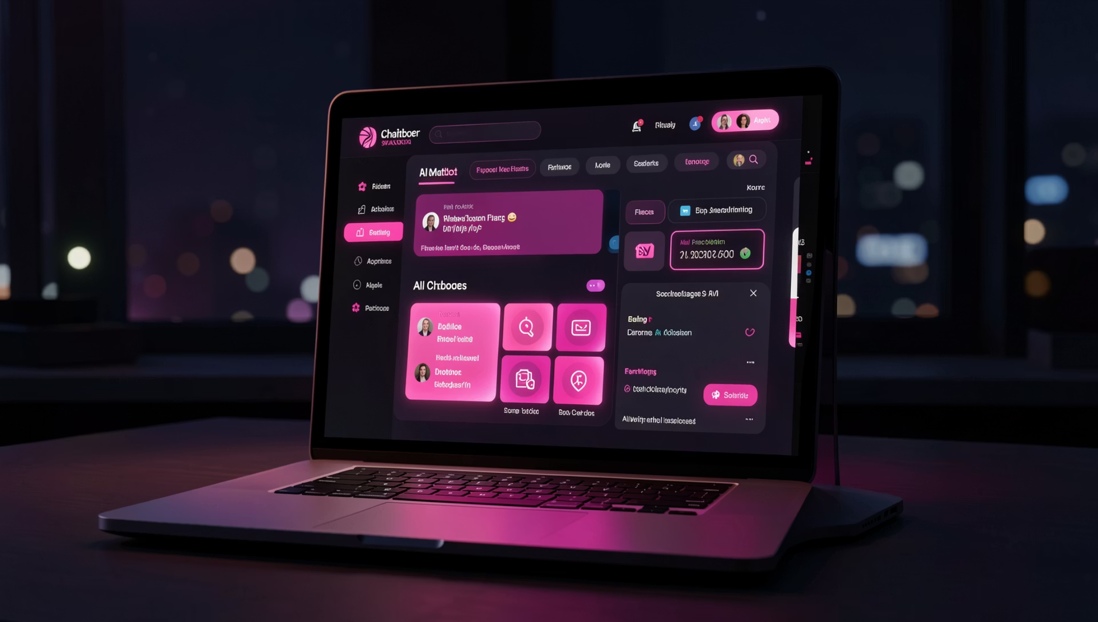

What You'll Build Today
Your AI-Powered App
Live, working web app
AI chat or content generator
Deployed in 90 minutes
Ship something real by the end of this session.

Slide 3
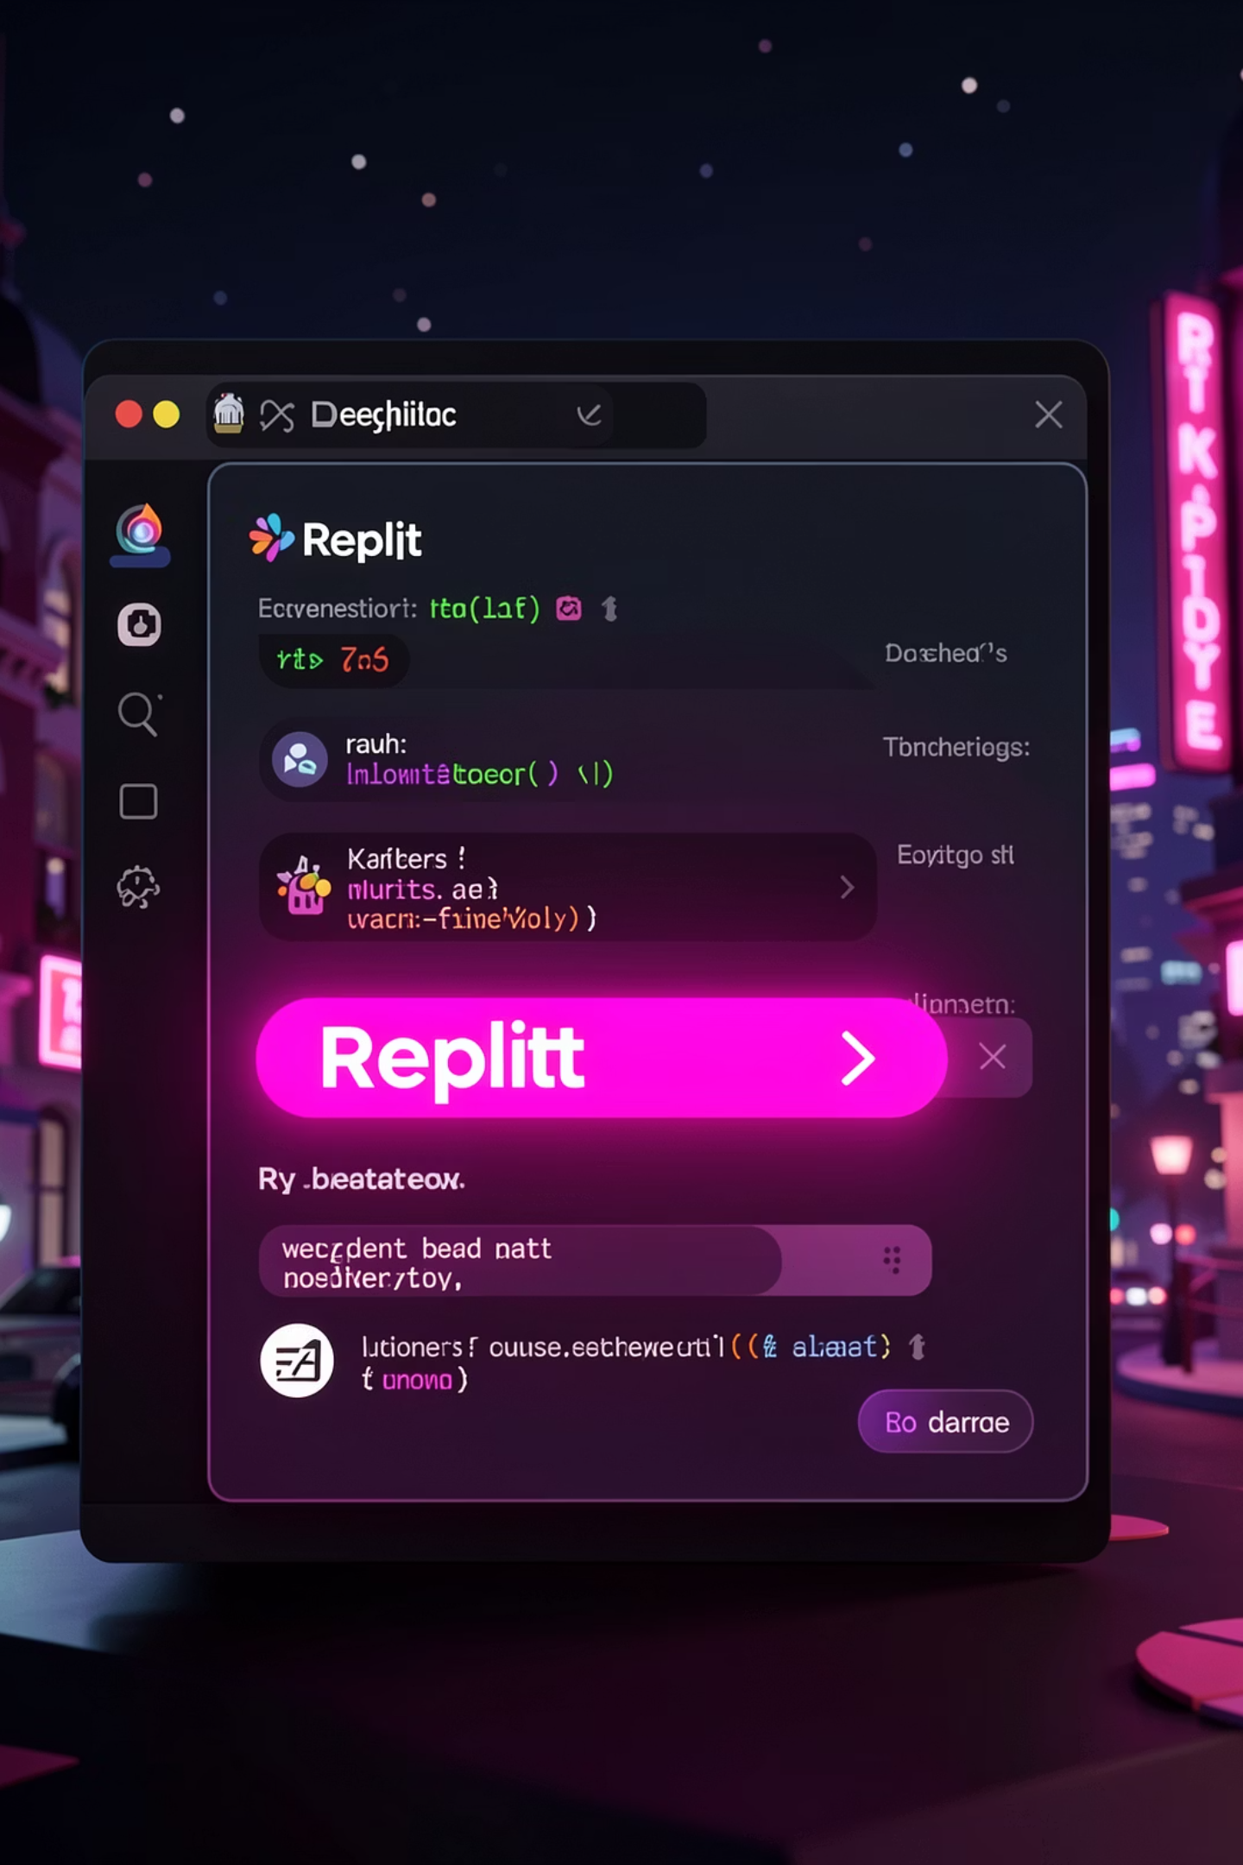



Why Replit?
Zero Installation
One-Click Hosting
No environment setup needed
Deploy instantly to live URL
Hackathon Perfect
Build fast, ship faster

Slide 4
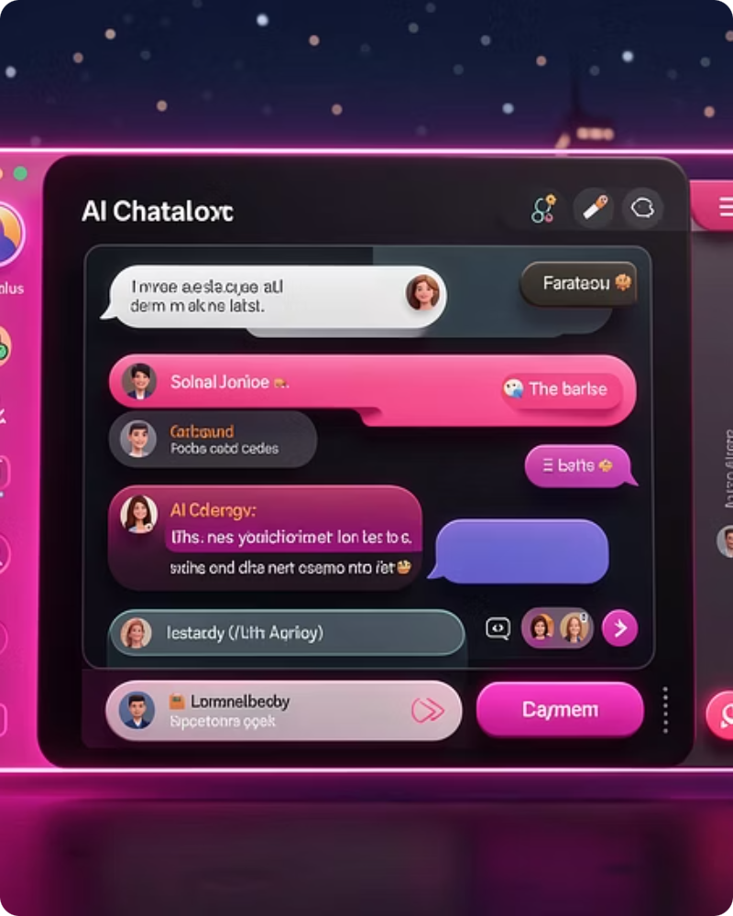
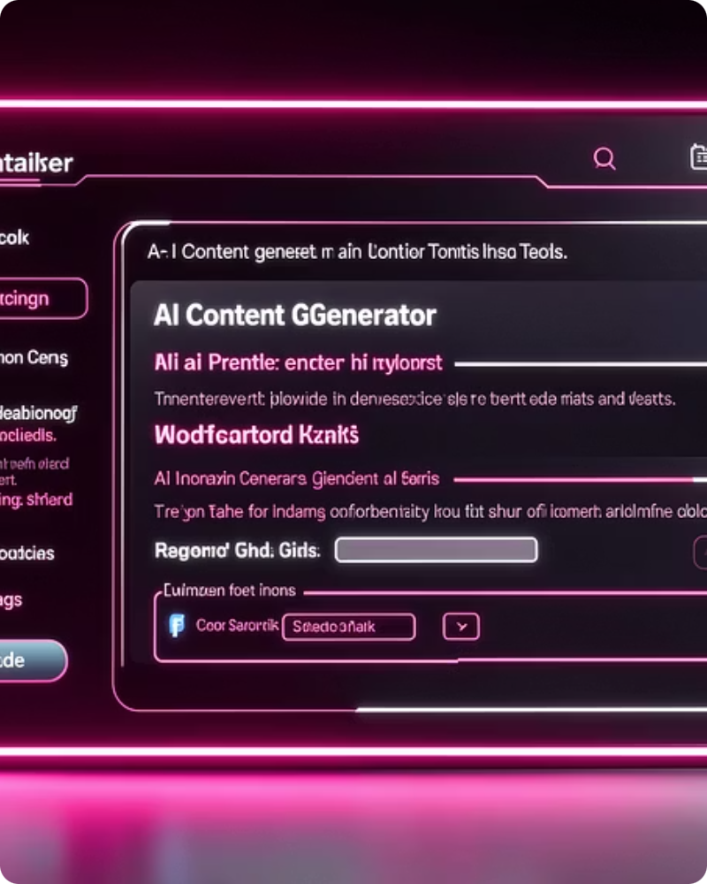
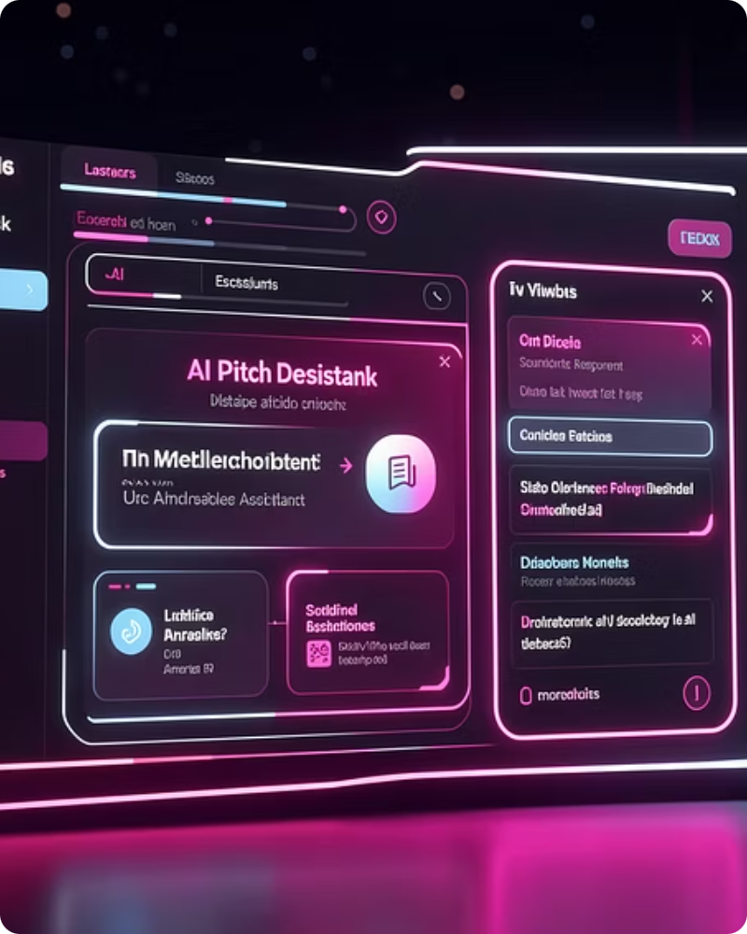
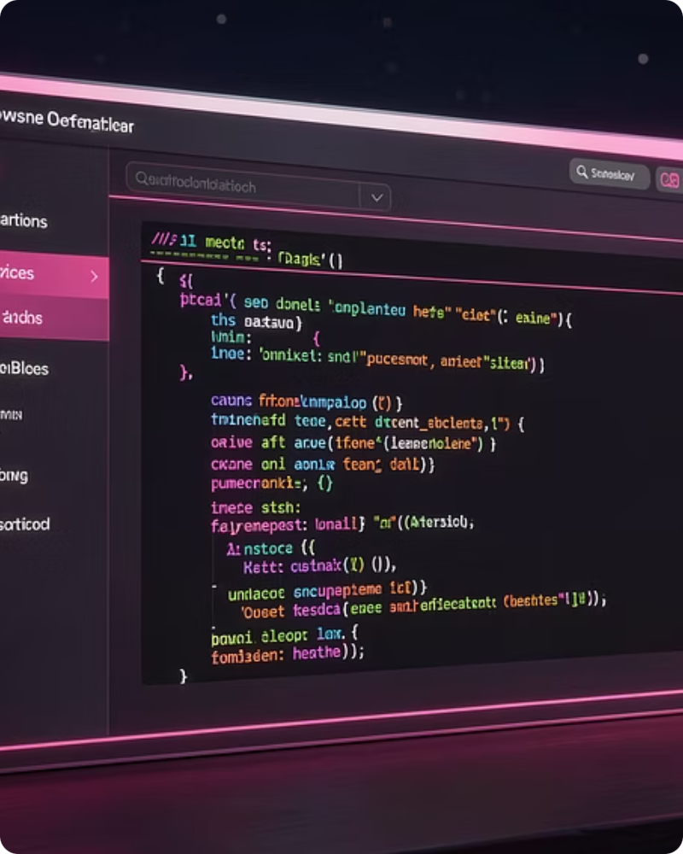
What Is an AI-Powered Web App?
A website that talks to an AI to generate responses or content
Chatbot
Content Generator
Pitch Writer
README Helper
Answer questions instantly
Create text on demand
Generate compelling pitches
Auto-document your projects

Slide 5




How It Works
User Input
Web App
You type a question or request
Your Replit-hosted interface
LLM API
AI Response
OpenAI, Groq, or Hugging Face
Generated content appears instantly

Slide 6
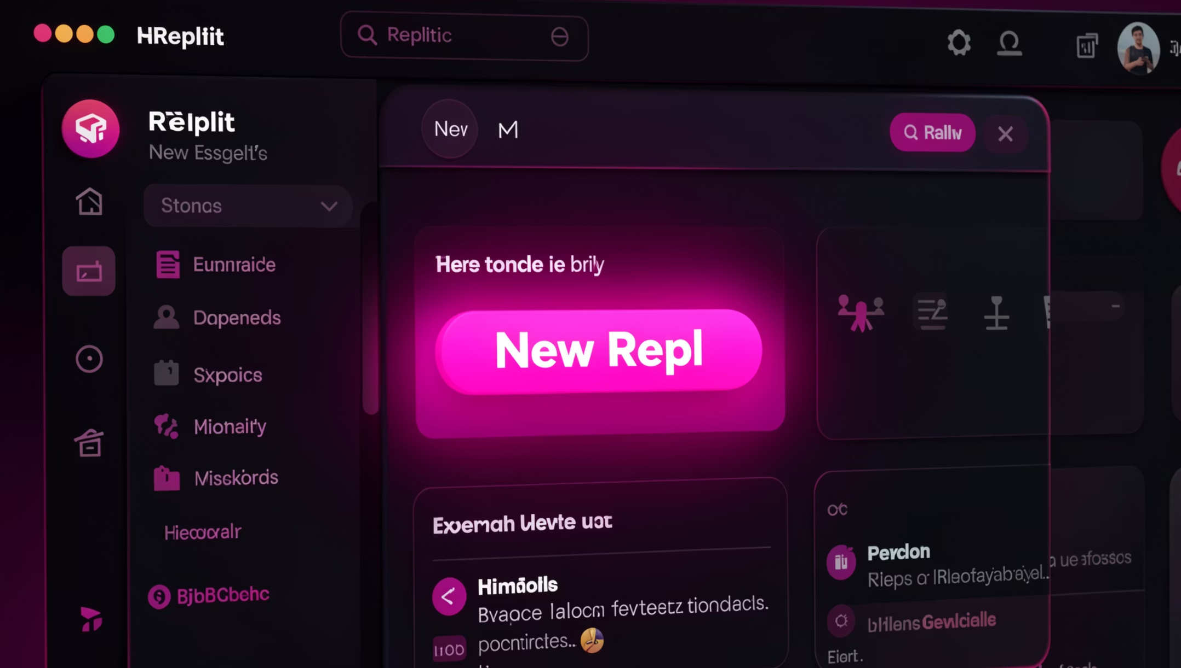
Step 1: Create Your Project
Getting Started
Open Replit dashboard
Click "New Repl"
Choose web template
Open the editor
Your development environment is ready instantly.

Slide 7

Step 2: Connect Your AI Backend
01
02
Get API Key
Store Securely
OpenAI / Groq / Hugging Face
Environment variables in Replit
03
Call the API
Connect your web app to AI cloud

Slide 8
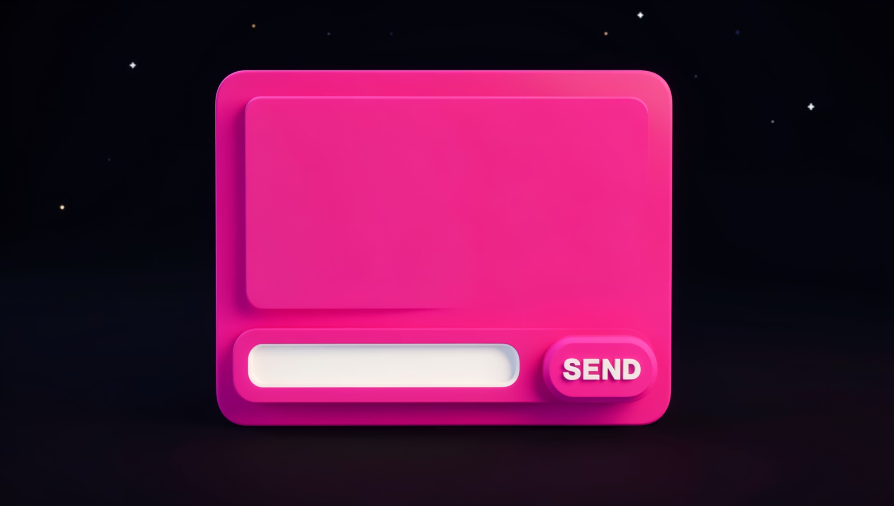
Step 3: Design Your UI
Drag-and-Feel Design
Input text box
Send button
Message area
Simple, clean layout
No complex coding required – keep it minimal and functional.

Slide 9




Step 4: Test & Launch
Ask Anything
Open Live URL
Test with real questions
Click "Run"
Share your working app
Launch your app in Replit

Slide 10


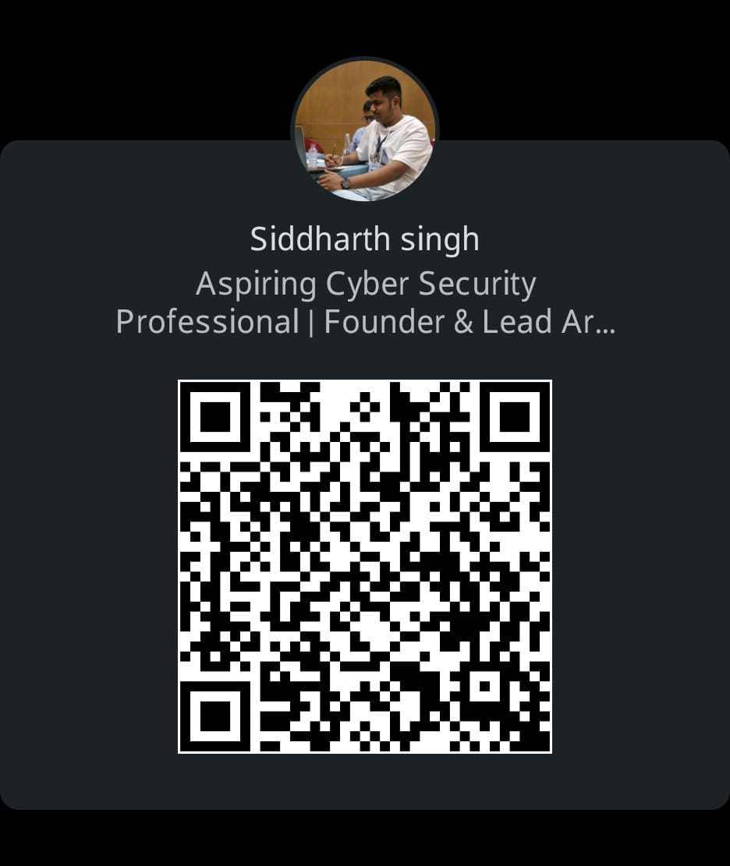
Feedback and Contact Info
Thanks
Siddharth Singh – Founder & CEO
henuos

